Slide 1
Climate Change , Vulnerability and Basic Understanding
Sharmind Neelormi

Slide 2
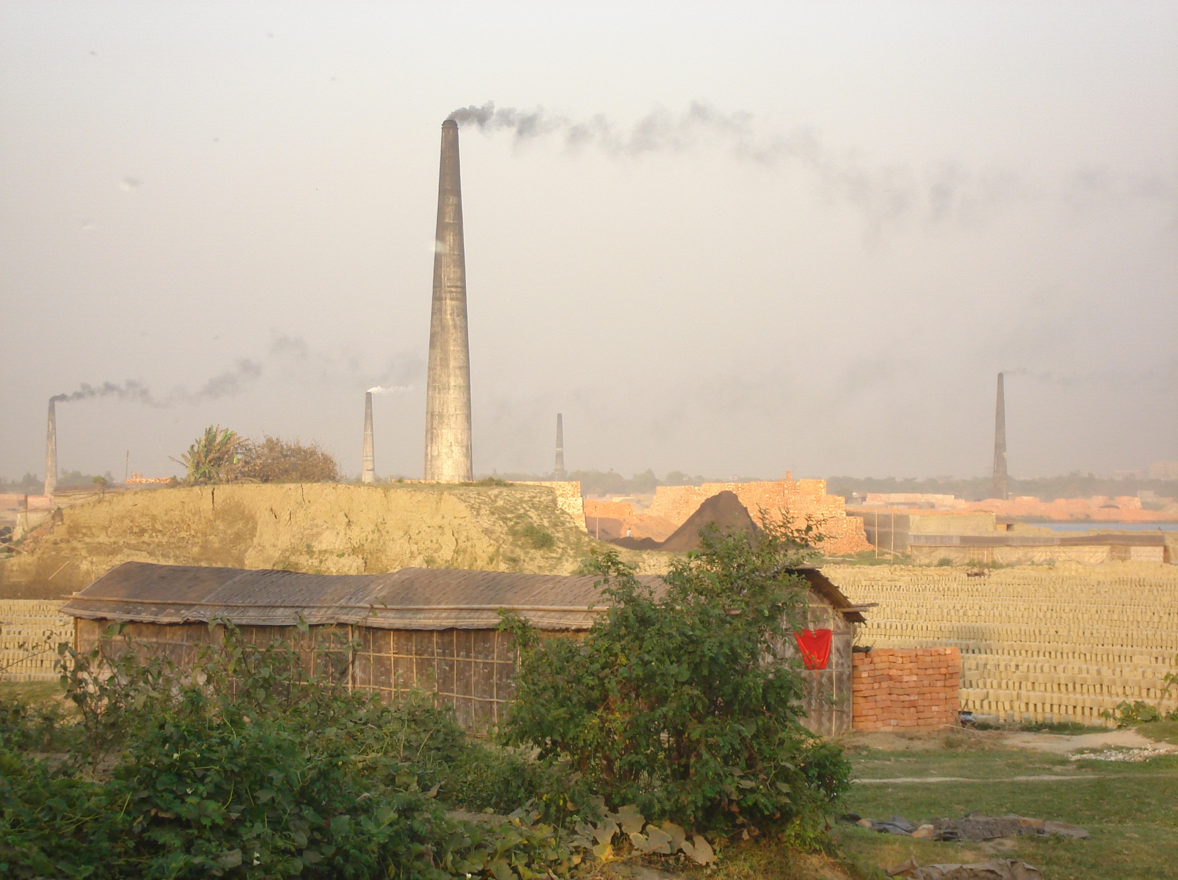


Climate Change is a Reality
IPCC Assessment warns that,
even if stabilization is possible at current levels of atmospheric concentration of CO2, the world is destined to face a net change of 0.1 degree C per decade over the next five decades.

Slide 3
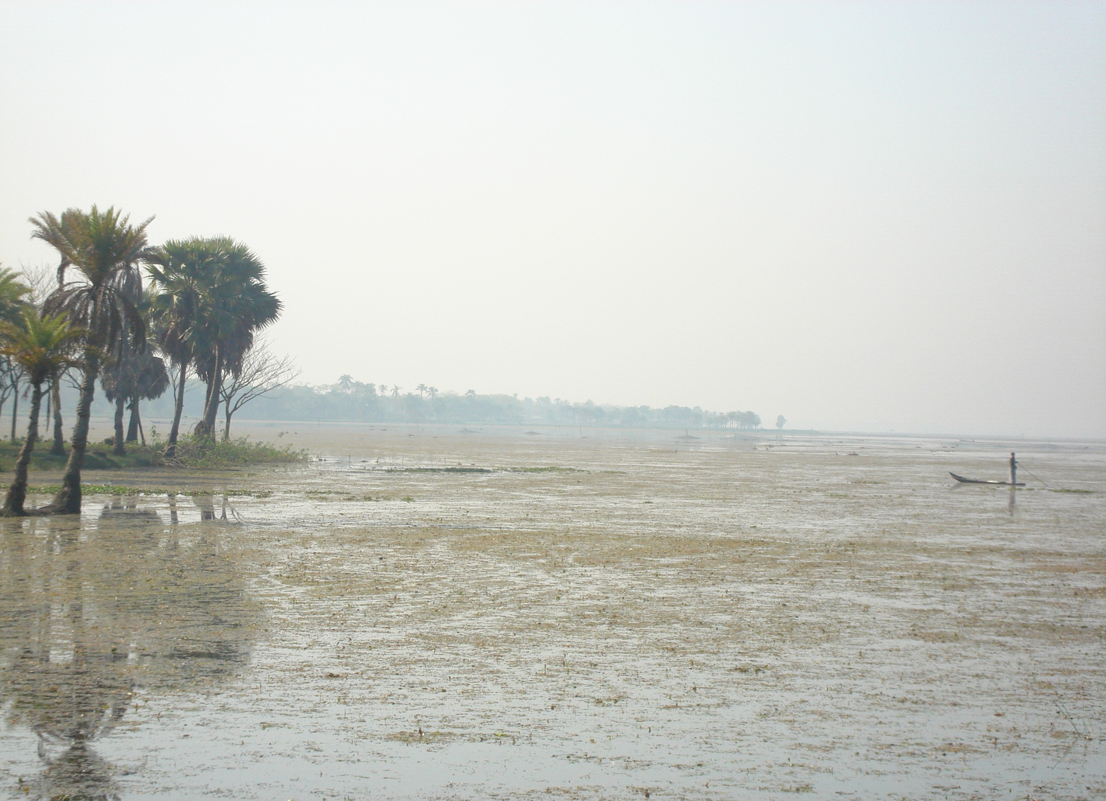

Avoid the Unmanageable
MITIGATION
Manage the Unavoidable
ADAPTATION

Slide 4
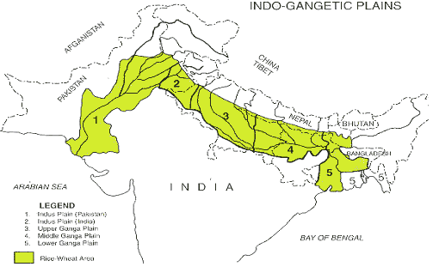
INDUS
GANGES

Slide 5
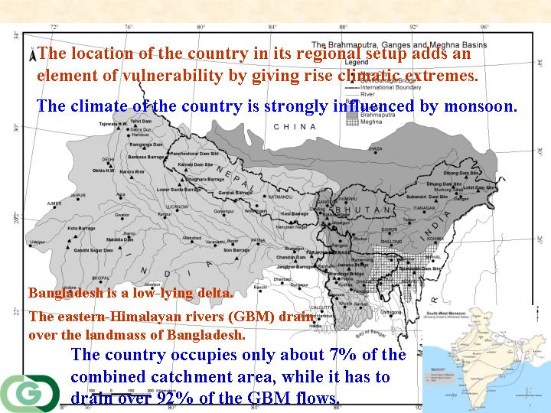

Slide 6
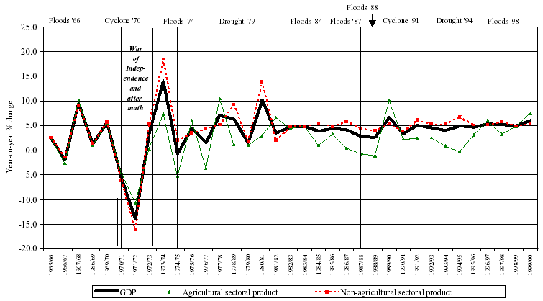
Figure : Relationship between disasters, and sectoral and national GDP
Source: Benson and Clay (2004)

Slide 7
Case Study: 1998 Flood
In FY 1999, Revenue fell short of target by 5.2%
Expenditure exceeded target by 5.2%
Exacerbating budget deficit on current account
For the first time in recent years expenditure under ADP exceeded its target by 2.4%
This surge in ADP expenditure in part reflected the demand of post-flood rehab. Program, where expenditure for repairing damage to infrastructure was needed to be stepped up
Overall deficit in public expenditure rose by 52.2 BnTk.
Deficit was financed through a combination of enhanced deficit financing through the banking system and foreign Aid

Slide 8
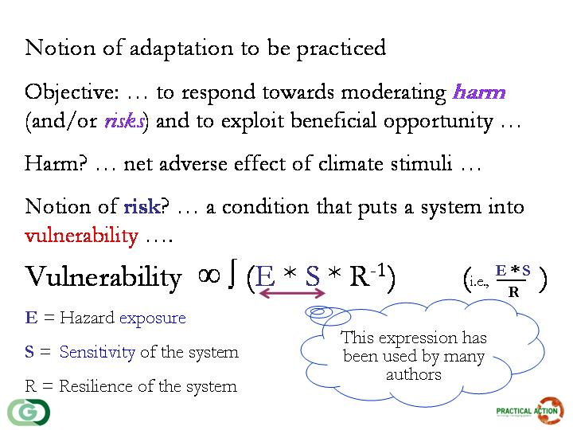
REDUCING VULNERABILITY

Slide 9
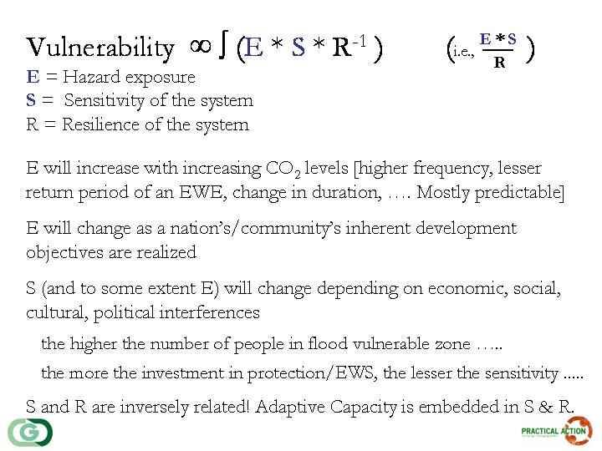

Slide 10

Understanding of Resilience
The ability of a substance or object to spring back into shape; elasticity.
The capacity to recover quickly from difficulties;
Robustness with a certain degree of flexibility
Bounce back alone is not desirable (+Thrive)
Definition
Resilience in a socio-economic system is defined as the capacity of a system to absorb disturbance and reorganize while undergoing change so as to still retain essentially the same function, structure, identity, and feedbacks (Holling, 1973; Walker et al., 2004).

Slide 11
Climate parameters
Erratic behaviour of such parameters
Flood
Drought
Salinity
Cyclone storm surge
Other aspects:
erosion, wave interaction, water logging
land slide

Slide 12
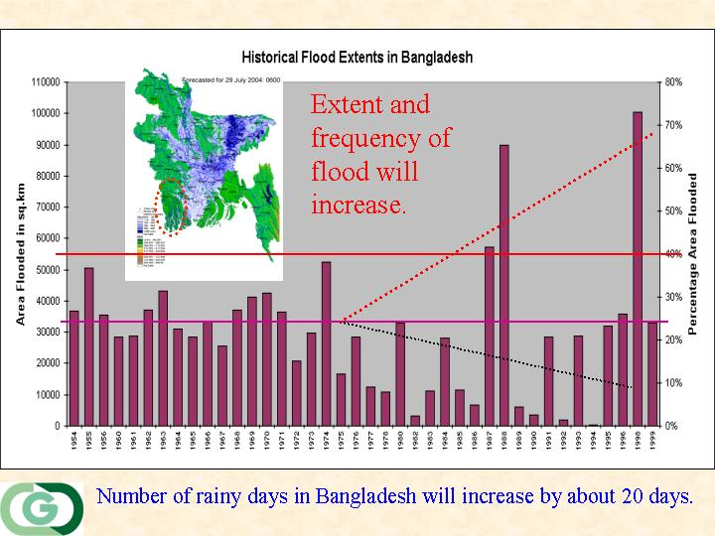
Notes:
12

Slide 13
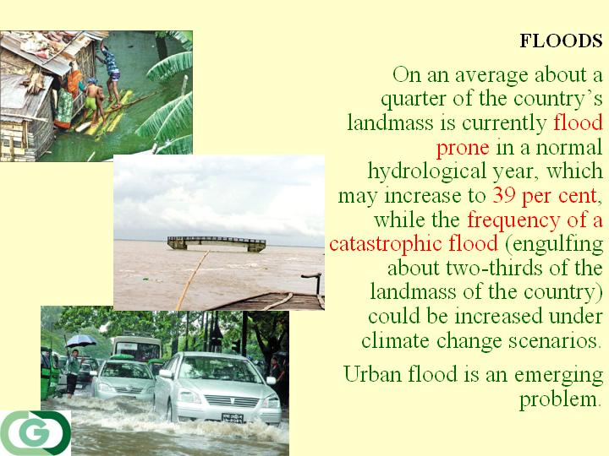
Notes:
13

Slide 14
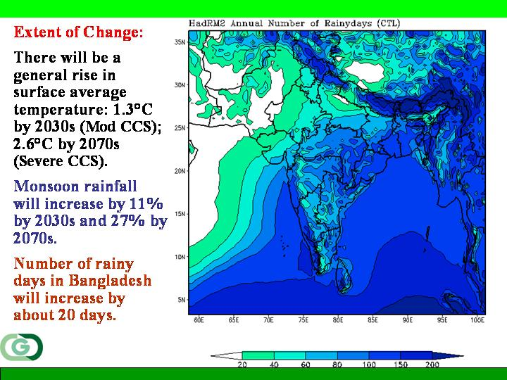

Slide 15
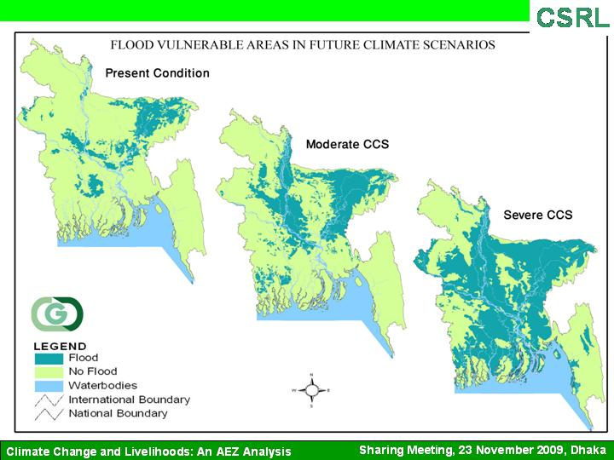
Source: Ahmed and Hussain, 2009

Slide 16
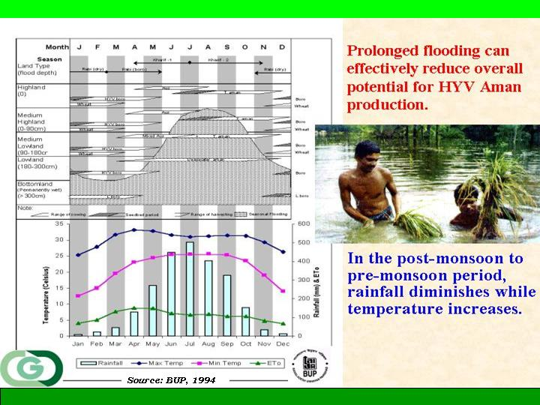

Slide 17

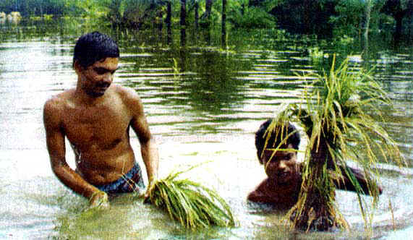

Expected new crest height (by means of adaptation)
Climate Change induced increased water level
Allowable Water Level
WATER LEVEL
TIME FRAME
March 30 - April 1
April 15
April 30 - May 1
May 15
SAFE TIME FOR BORO HARVEST

Slide 18
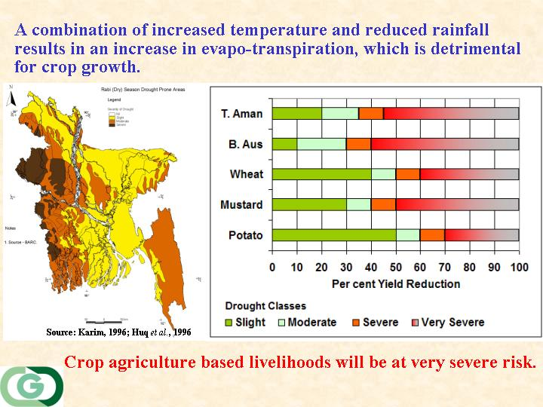
Notes:
18

Slide 19
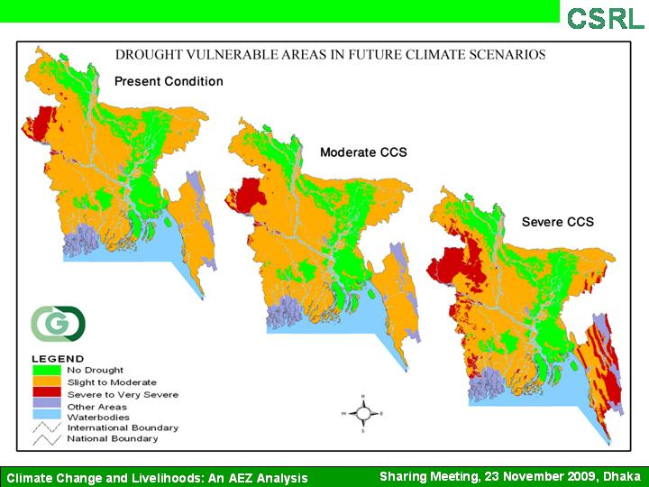
Sharing Meeting, 12 March 2011, Dhaka
Climate Change Impacts on Bangladesh’s Economy
Source: Ahmed and Hussain, 2009

Slide 20
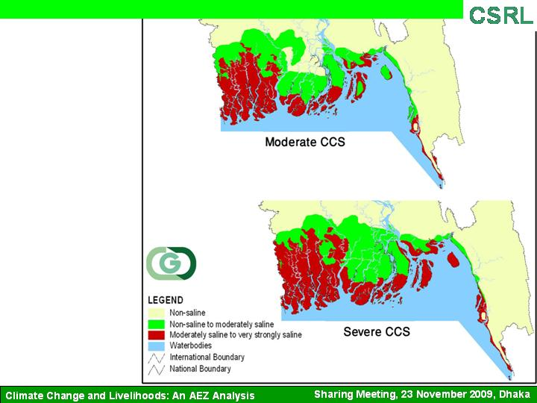

Source: Ahmed and Hussain, 2009

Slide 21
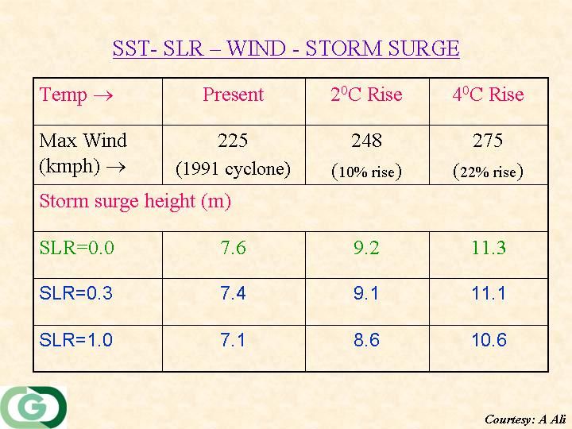

Slide 22
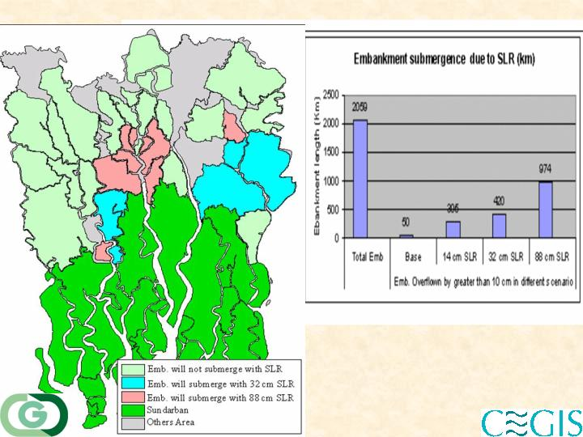
Source: CEGIS, 2006
Notes:
22

Slide 23
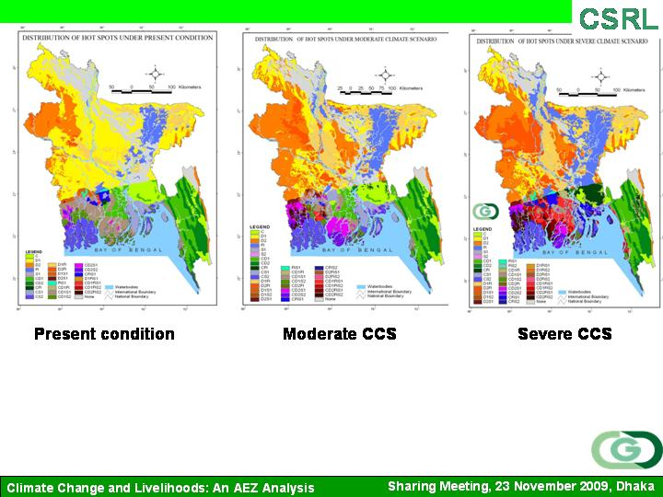
The coastal areas will be hit hard due to a combination of hazards.

Slide 24
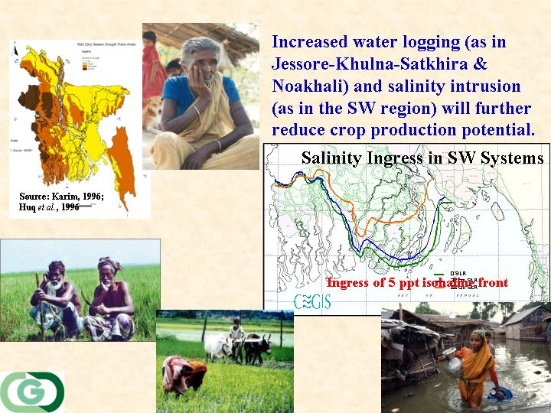
Source: CEGIS, 2006
Notes:
24

Slide 25
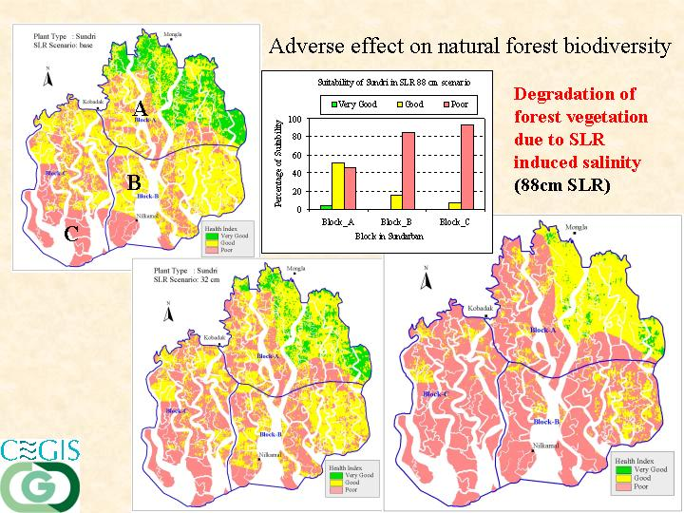
Source: CEGIS, 2006
Notes:
25

